Slide 1
Weekly report: Grid Code Development
Week number: 6
Date: 4/11/2025
Supervisor: Prof. Ing. Saiju
Presented by: Josef Remberger / Vijay Simha Reddy Bogala

Slide 2
List of contents
Milestones
State of the art Grid Code
  Basic Data
  Fault Ride Through (FRT)
  Droop Characteristics
Advices for changing Grid Code
PowerFactory
Josef Remberger

Slide 3
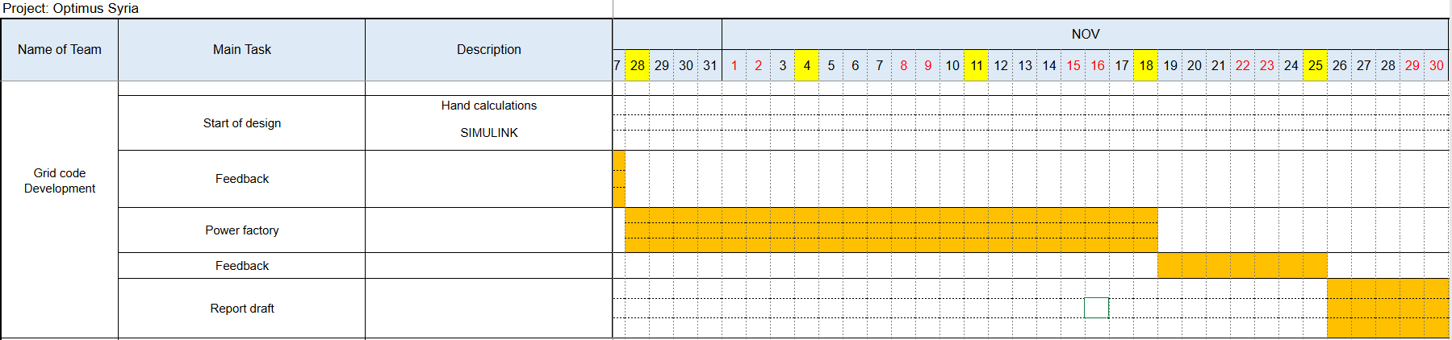
1. Milestones
Josef Remberger

Slide 4
2-i. Basic Data
Operation state | Frequency [Hz] | Voltage [kV]
Normal | 49.90 – 50.10 | 59.5 – 72.5 / 207 – 241.5
System stress | 48.75 – 51.25 | 59.5 – 72.5 / 207 – 241.5
Emergency / extreme fault | 47.5 ≤ X ≥ 51.5 Hz | 59.5 < X > 72.5 / 207.0 < X > 241.5
Restorative / black start | - | -
[1]
Josef Remberger

Slide 5
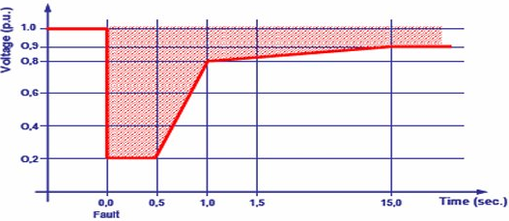
2-ii. Fault Ride Through (FRT)
  Low voltage ride through behaviour (LVRT)
  High voltage ride through behaviour (HVRT)
Not mentioned !
Voltage Profile Recovery of Wind Generators During and After a voltage sag; [1] PETE; (01/11/2025)
[1]
Josef Remberger

Slide 6
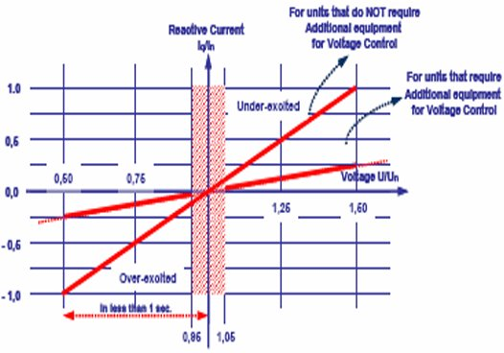
2-iii. Droop Characteristics
  Reactive Power / voltage control
  Active Power/ frequency control
Not mentioned !
Minimum requirements for a non-synchronous machine in
voltage control; [1] PETE; (01/11/2025)
[1]
Josef Remberger

Slide 7
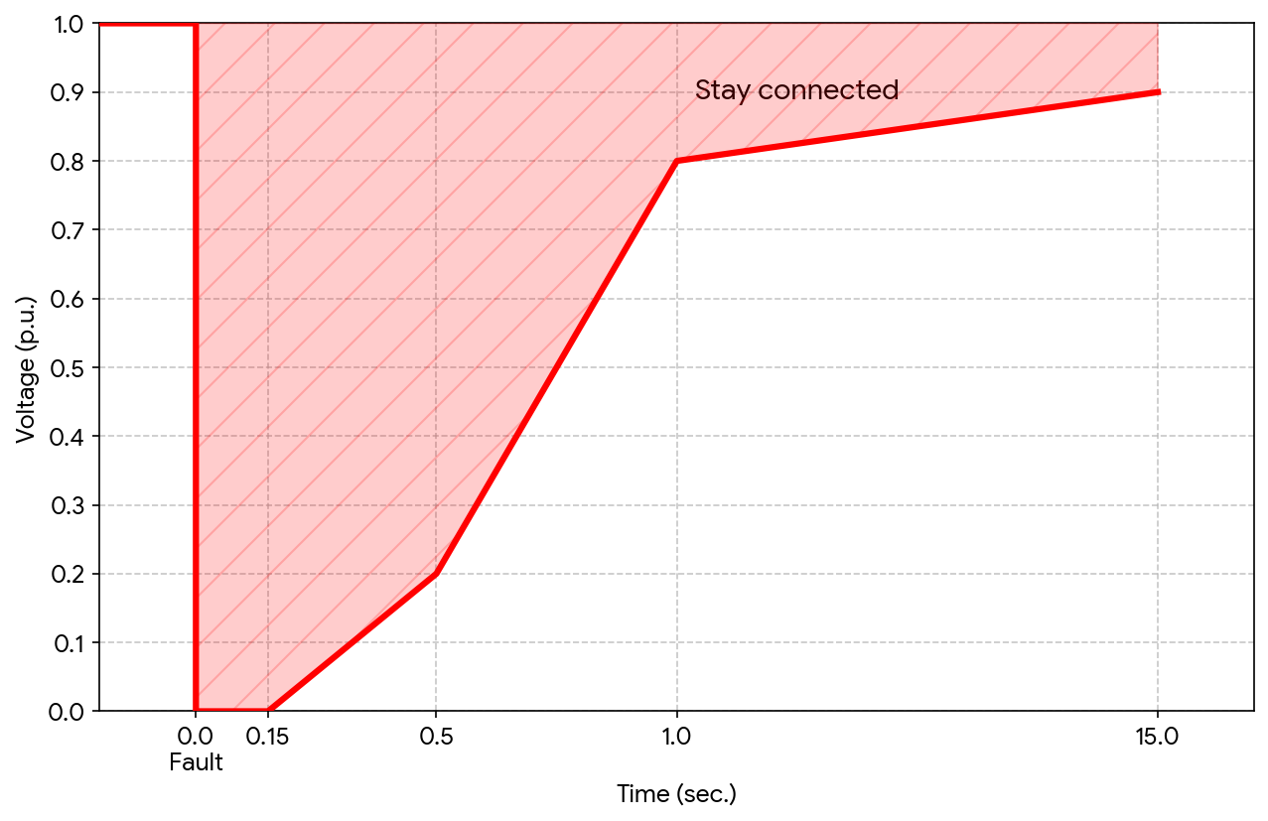
3. Advices for changing Grid Code
LVRT
Change from 80% sag to 100% for 150 ms
-> Improvement of grid stability
[1], [2]
Improved low voltage ride through behaviour; [1],[2] PETE and VDE-AR-N 4110:2017-02; (01/11/2025)
Josef Remberger

Slide 8
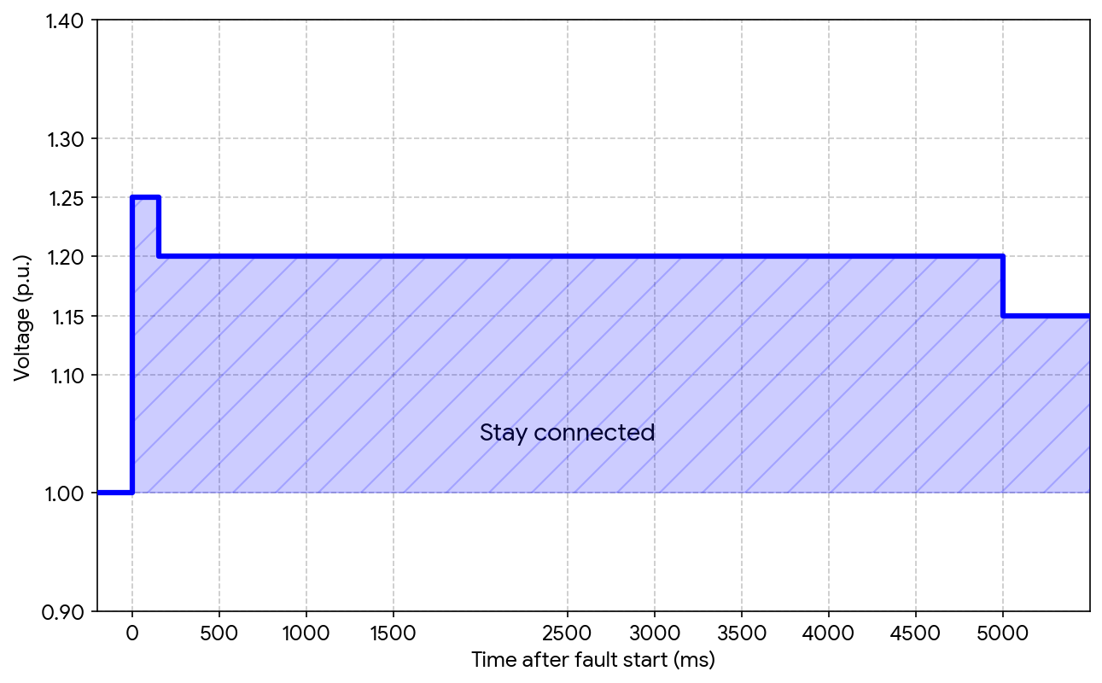
3. Advices for changing Grid Code
HVRT
According to VDE-AR-N 4110:2017-02
Staying connected during surges
-> Improvement of grid stability
[2]
High voltage ride through behaviour according to VDE-AR-N 4110:2017-02; [2]; (01/11/2025)
Josef Remberger

Slide 9

3. Advices for changing Grid Code
Reactive power / voltage control
Staying with the current code
-> due to high voltage fluctuations in the
grid
Minimum requirements for a non-synchronous machine in voltage control; [1] PETE; (01/11/2025)
[1]
Josef Remberger

Slide 10
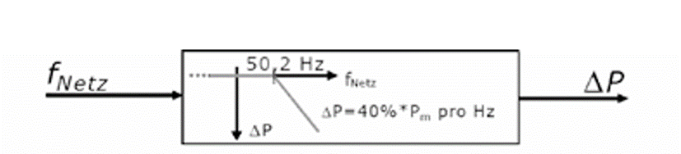
3. Advices for changing Grid Code
Active power / frequency
Normal operation f = 49.8 – 50.2 Hz
$∆P=20 P_{N}\frac{50.2 Hz −f_{grid}}{50 Hz}$ for 50.2 Hz < $f_{grid }$< 51.5 Hz
[3]
Josef Remberger

Slide 11
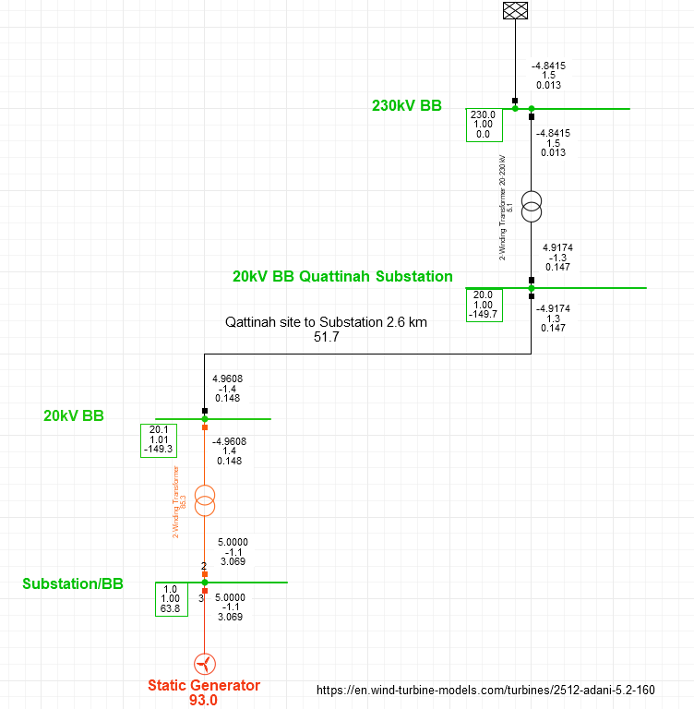
4. PowerFactory
Load Flow Calculation
WT: P = 5MW
Busbar: 0.96kV
Transformer: 0.96/20kV
Busbar: 20kV
Cable: NA2XS(F)2Y 1x120RM 12/20kV; 2.6 km
Busbar: 20kV
Transformer: 20/230kV
External Grid
Josef Remberger

Slide 12
Bibliography – Grid Code Development
[1] SYRRIAN ARAB REPUBLIC / Ministry of Electricity / PETE / Transmission Grid Code, 2014 (accessed Nov. 1, 2025)
[2] “Summary of the draft VDE-AR-N 4110:2017-02” VDE, 2017. https://eepublicdownloads.entsoe.eu/clean-documents/cnc-active-library/Germany/summary-draft-4110-en.pdf (accessed Nov.1, 2025)
[3] “Windkraftanlagen - Systemauslegung, Netzintegration und Regelung”, S.Heier 2022. (accessed Nov.1, 2025)
Josef Remberger

